Slide 1

Introducing reCAPTCHA to Our GKE API Platform
Enhance your API security with Google's reCAPTCHA. This powerful tool protects against spam and abuse. It ensures human users while blocking automated attacks.
Let's explore how reCAPTCHA can revolutionize your GKE API platform's security measures.

Slide 2

What is reCAPTCHA?
Google's Security Tool
reCAPTCHA is a free service provided by Google. It's designed to protect websites from fraudulent activities.
Human Verification
The primary purpose is to distinguish between human users and automated bots. This ensures genuine user interactions.
Continuous Evolution
reCAPTCHA has evolved from text-based challenges to more sophisticated, user-friendly methods. It adapts to emerging threats.

Slide 3

The Functions of reCAPTCHA
1
Prevent Automated Attacks
reCAPTCHA acts as a barrier against malicious bots. It stops them from accessing your API and causing harm.
2
Verify User Identity
It confirms human presence during form submissions. This ensures legitimate access to specific API operations.
3
Offer Multiple CAPTCHA Types
reCAPTCHA v2 uses visual challenges. reCAPTCHA v3 provides a seamless experience based on user behavior scores.

Slide 4
The Benefits of reCAPTCHA
Enhanced Security
User-Friendly Experience
Simple Integration
reCAPTCHA effectively prevents spam and malicious activities. It adds a robust layer of protection to your API.
reCAPTCHA is compatible with various tech stacks. It's easy to implement in both front-end and back-end systems.
The v3 version offers a smooth, unobtrusive user experience. It doesn't interrupt the user's workflow.

Slide 5




Implementing reCAPTCHA in GKE: Steps 1-2
Create reCAPTCHA Project
Set up an application in the Google Developer Console. Obtain your unique API key for integration.
Front-End Integration
Load the reCAPTCHA script in your web application. Add the widget to forms requiring verification.
Customize Appearance
Adjust the reCAPTCHA widget to match your site's design. Ensure it blends seamlessly with your UI.

Slide 6

Implementing reCAPTCHA in GKE: Step 3
1
Receive User Response
Capture the reCAPTCHA response submitted by the user. This is typically a token.
2
Send Verification Request
Use the token to send a verification request to Google's API. This confirms the validity.
3
Parse Verification Result
Analyze the response from Google. Determine if the user passed the reCAPTCHA challenge.
4
Process Request
Based on the verification result, decide whether to proceed with the user's request.

Slide 7
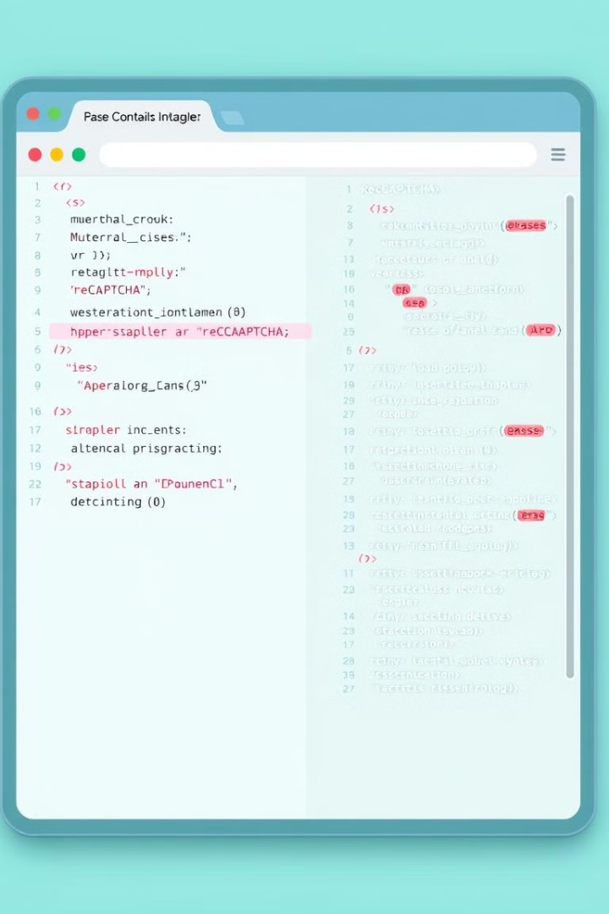
Sample Code for reCAPTCHA Implementation
Front-End (HTML)
Back-End (Python)
<script src="https://www.google.com/recaptcha/api.js" async defer></script>
import requests
<form action="YOUR_BACKEND_ENDPOINT" method="POST">
def verify_recaptcha(recaptcha_response):
<div class="g-recaptcha" data-sitekey="YOUR_SITE_KEY"></div>
secret_key = "YOUR_SECRET_KEY"
<button type="submit">Submit</button>
response = requests.post("https://www.google.com/recaptcha/api/siteverify", ...)

Slide 8




Conclusion: Secure Your API with reCAPTCHA
Enhanced Security
reCAPTCHA significantly boosts your API's defense against automated attacks and spam.
Improved User Experience
With seamless integration, reCAPTCHA enhances security without compromising user satisfaction.
Easy Implementation
Simple integration steps make reCAPTCHA an accessible solution for developers of all levels.

